Slide 1
Pet Project 🐶🐱🐹
Aaron Foster

Slide 2
Overview
Pet Project 🐶🐱🐹
WatchKit?
The Game
The Demo

Slide 3

WatchKit?
Pet Project 🐶🐱🐹
Deprecated & Dismissed
Replaced by SwiftUI
New Focus

Slide 4
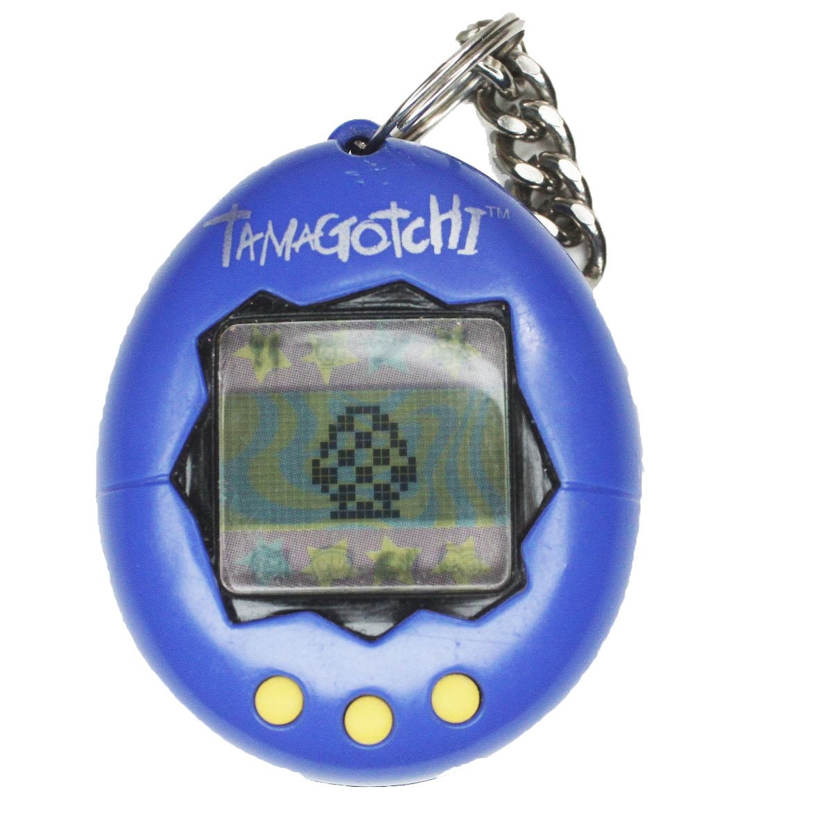
The Game
Pet Project 🐶🐱🐹
Tamagotchi
Included Features
Improving Features

Slide 5
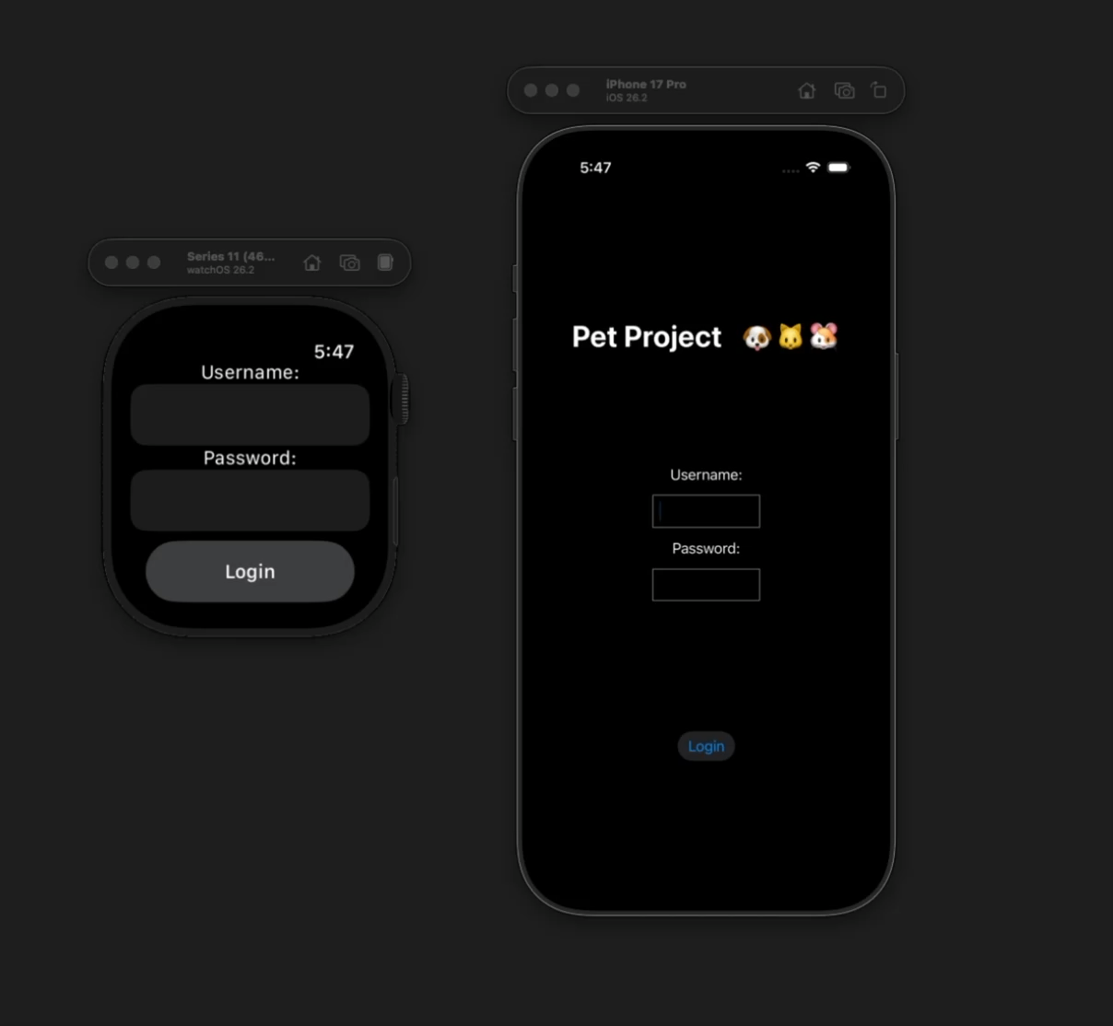
The Demo
Pet Project 🐶🐱🐹

